Slide 1
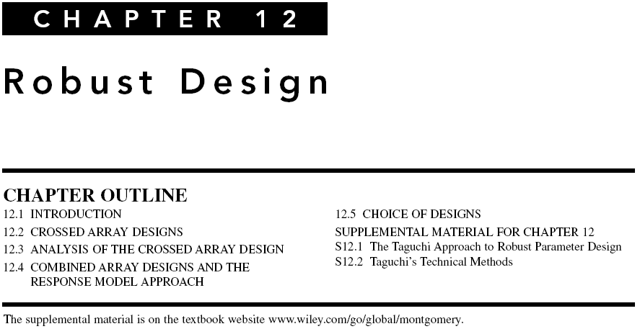
Chapter 12
Design & Analysis of Experiments 8E 2012 Montgomery

Slide 2
Robust Design
Goal is to make products and processes robust or less sensitive to variability transmitted by factors that cannot be easily controlled
Methods for RPD or robust parameter design was developed by Taguchi starting in the 1950s and introduced to western industry in the 1980s
Taguchi methods generated much controversy
Subsequent research produced an improved approach based on RSM
Chapter 12
Design & Analysis of Experiments 8E 2012 Montgomery

Slide 3
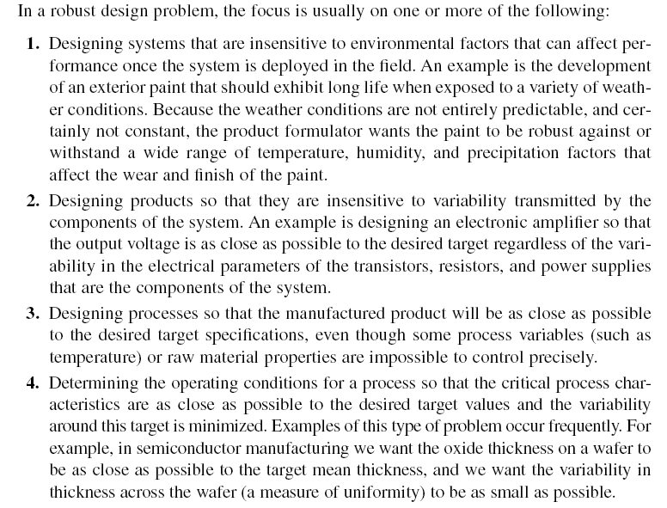
Chapter 12
Design & Analysis of Experiments 8E 2012 Montgomery

Slide 4
Noise variables transmit variability into the response
Noise variables cannot be controlled in the end application, but can be controlled for purposes of an experiment (assumption)
Objective is to determine the levels of the controllable variables that minimize the variability transmitted from the noise variables
This approach is not always applicable – if the noise factors dominate, other methods must be considered
  changing the design or the process – for example, manufacturing ICs in a clean room to eliminate defects due to microscopic particles or contaminants
  Sometimes technological factors can be employed to reduce noise – for example, substituting electronic components for mechanical ones
Chapter 12
Design & Analysis of Experiments 8E 2012 Montgomery

Slide 5
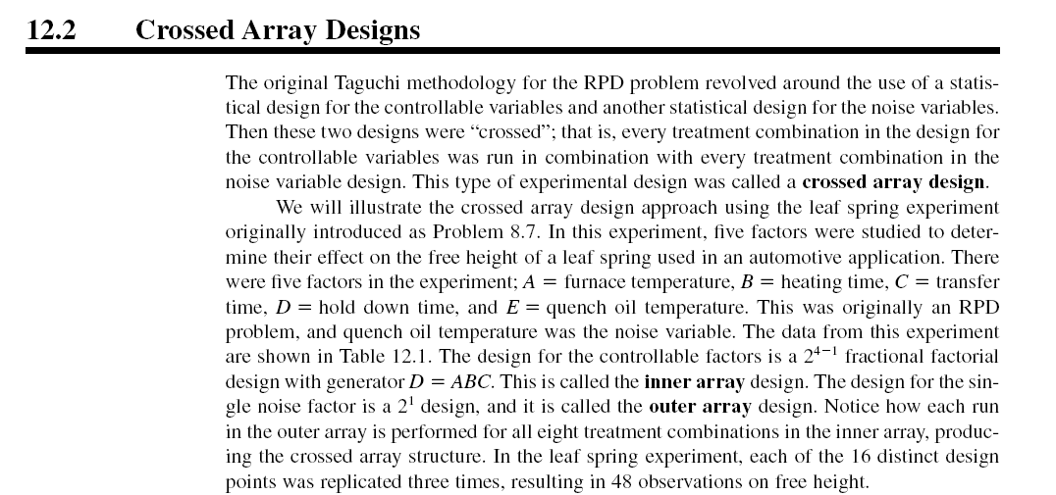
Chapter 12
Design & Analysis of Experiments 8E 2012 Montgomery

Slide 6
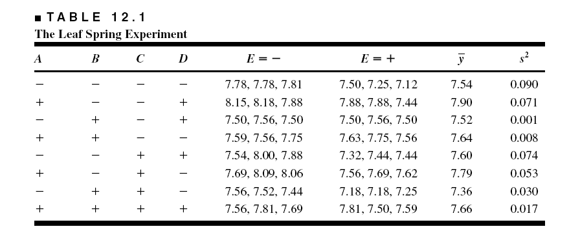
Chapter 12
Design & Analysis of Experiments 8E 2012 Montgomery

Slide 7
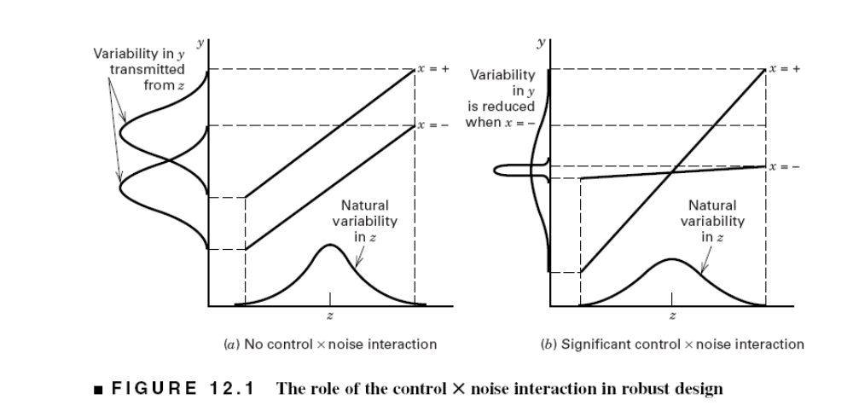
Chapter 12
Design & Analysis of Experiments 8E 2012 Montgomery

Slide 8
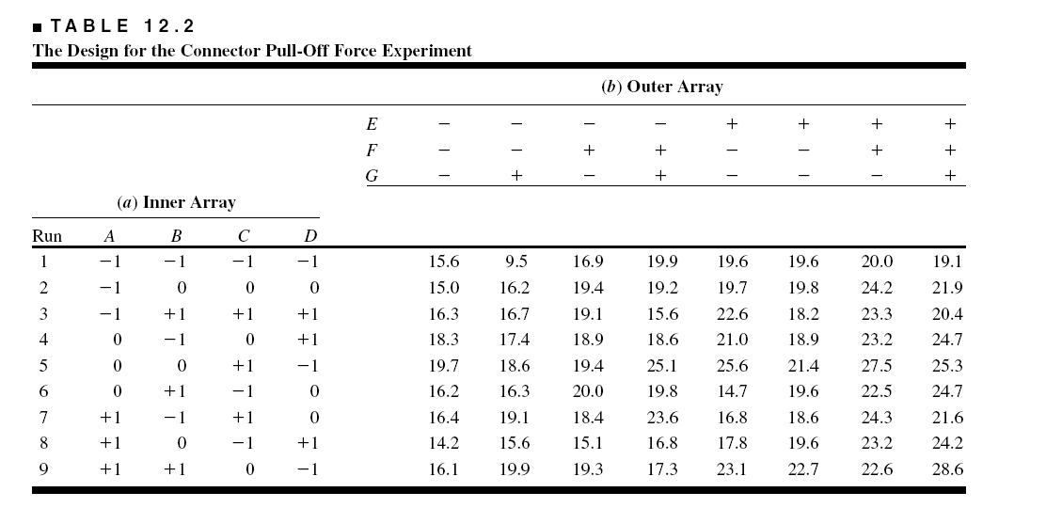
Chapter 12
Design & Analysis of Experiments 8E 2012 Montgomery

Slide 9
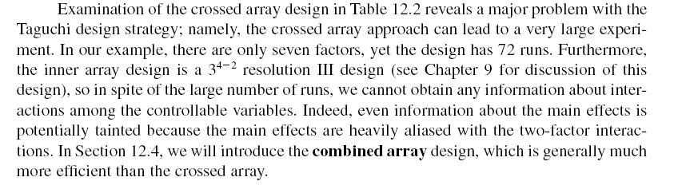
Chapter 12
Design & Analysis of Experiments 8E 2012 Montgomery

Slide 10
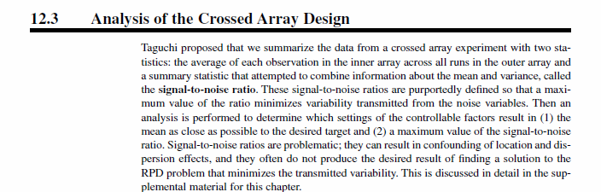
A better approach is to model the mean and variance directly
Chapter 12
Design & Analysis of Experiments 8E 2012 Montgomery

Slide 11
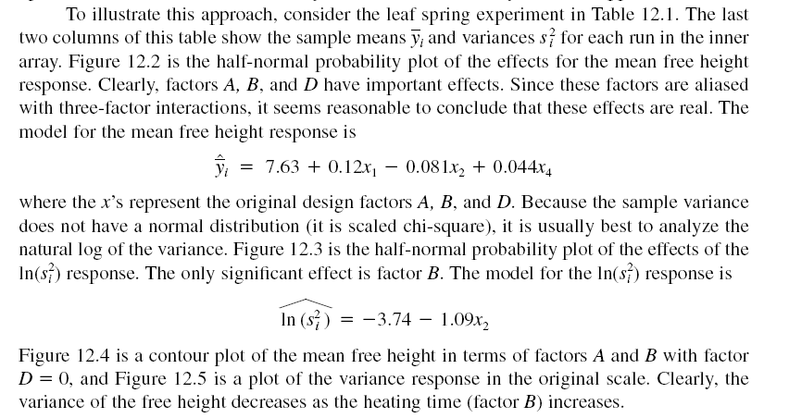
Chapter 12
Design & Analysis of Experiments 8E 2012 Montgomery

Slide 12
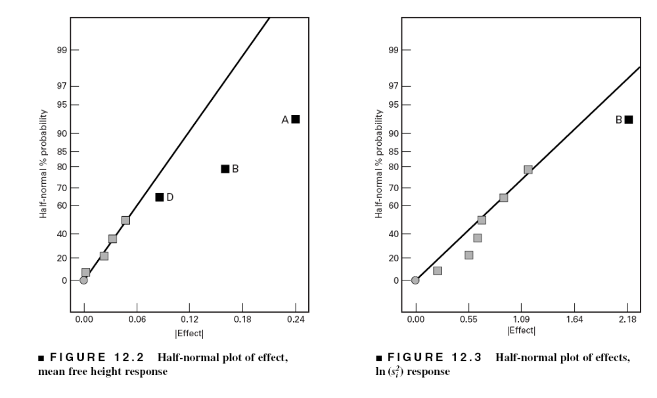
Chapter 12
Design & Analysis of Experiments 8E 2012 Montgomery

Slide 13
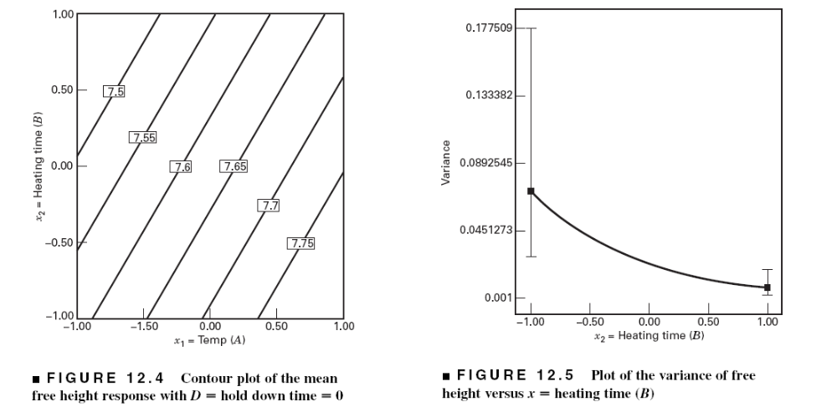
Chapter 12
Design & Analysis of Experiments 8E 2012 Montgomery

Slide 14
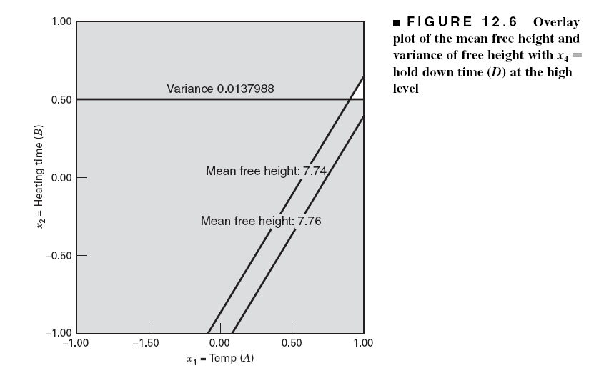
Chapter 12
Design & Analysis of Experiments 8E 2012 Montgomery

Slide 15
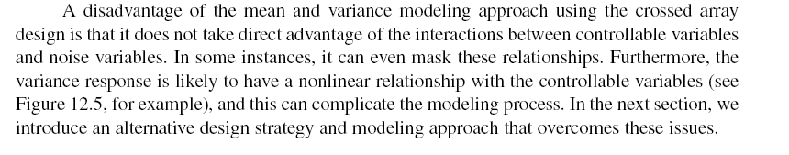
Chapter 12
Design & Analysis of Experiments 8E 2012 Montgomery

Slide 16
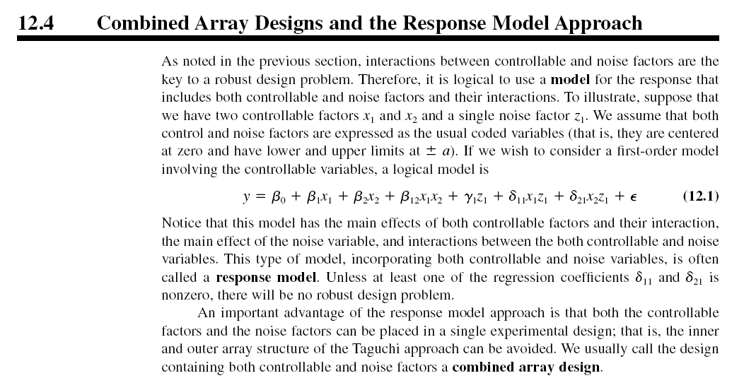
Chapter 12
Design & Analysis of Experiments 8E 2012 Montgomery

Slide 17
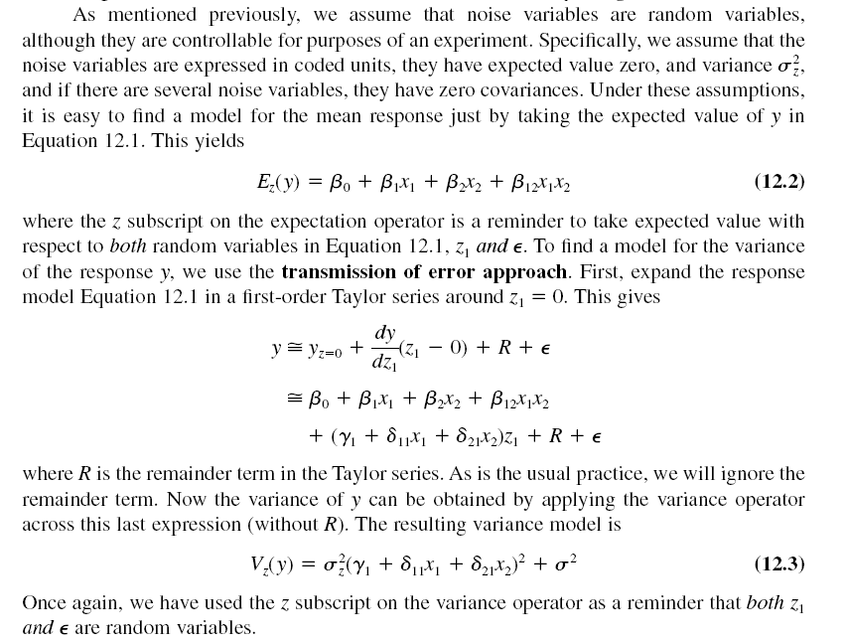
Chapter 12
Design & Analysis of Experiments 8E 2012 Montgomery

Slide 18
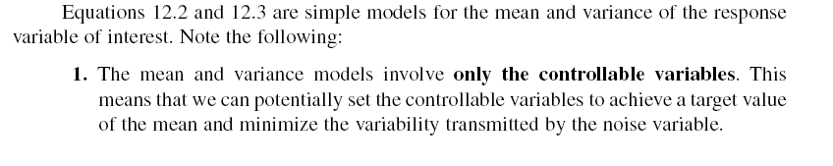
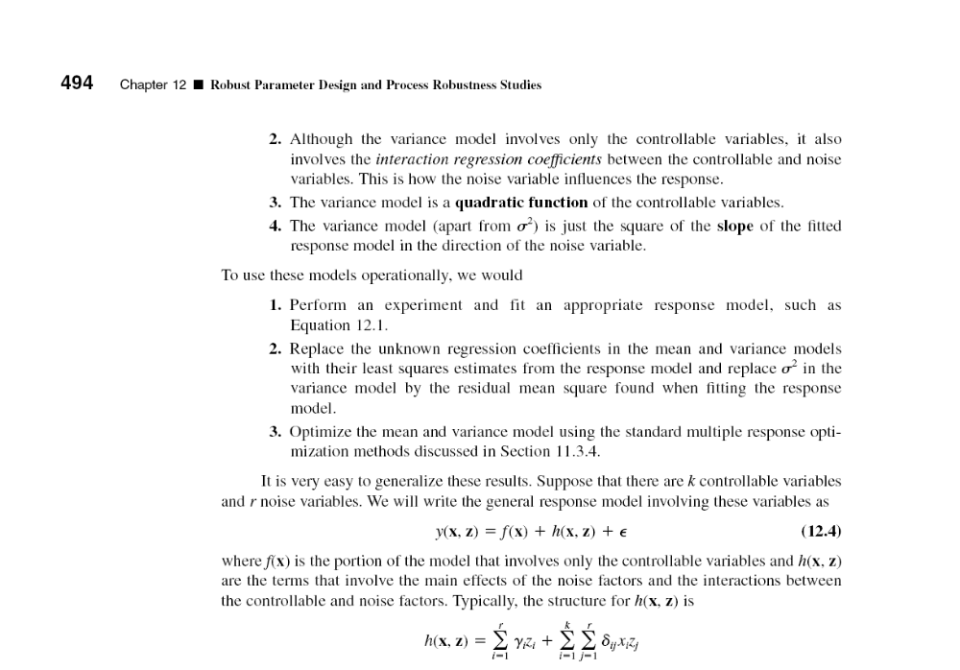
Chapter 12
Design & Analysis of Experiments 8E 2012 Montgomery

Slide 19
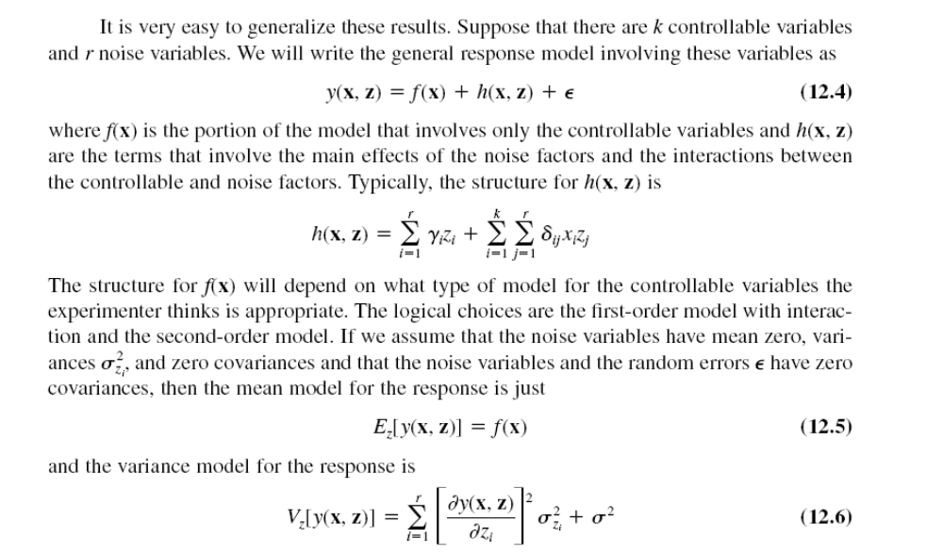
Chapter 12
Design & Analysis of Experiments 8E 2012 Montgomery

Slide 20
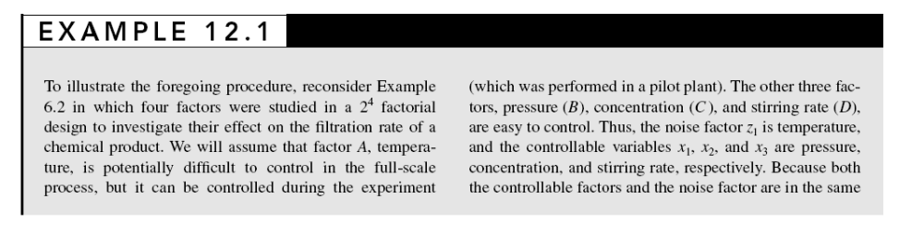
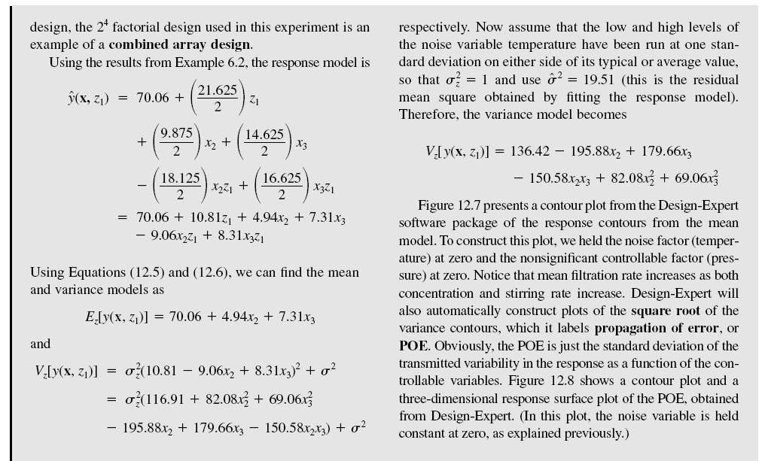
Chapter 12
Design & Analysis of Experiments 8E 2012 Montgomery

Slide 21
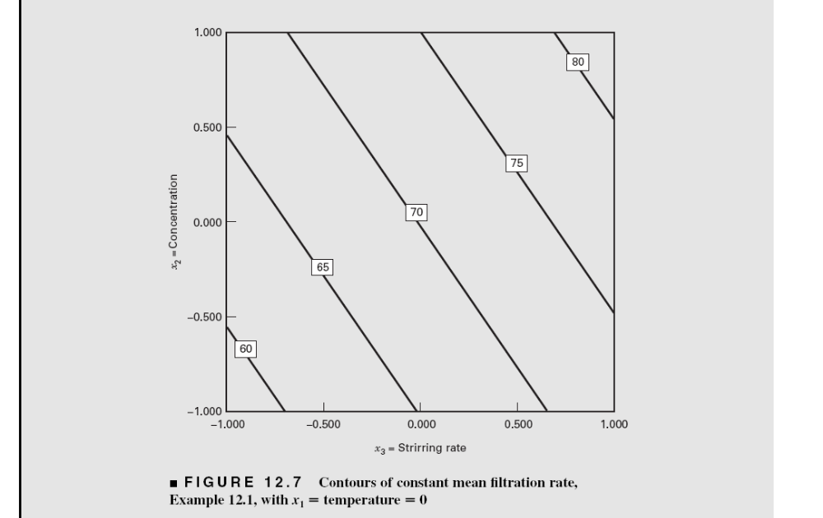
Chapter 12
Design & Analysis of Experiments 8E 2012 Montgomery

Slide 22
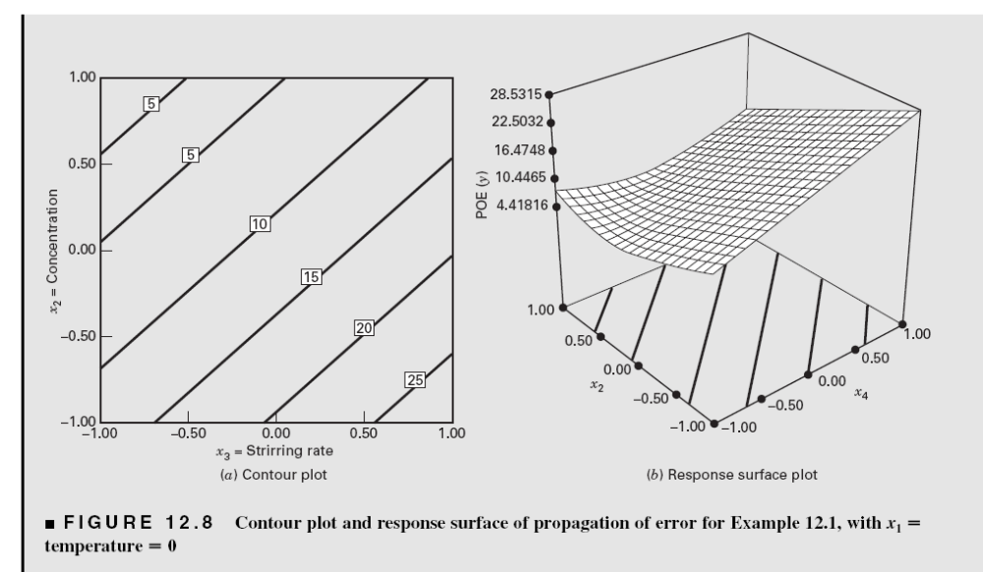
Chapter 12
Design & Analysis of Experiments 8E 2012 Montgomery

Slide 23
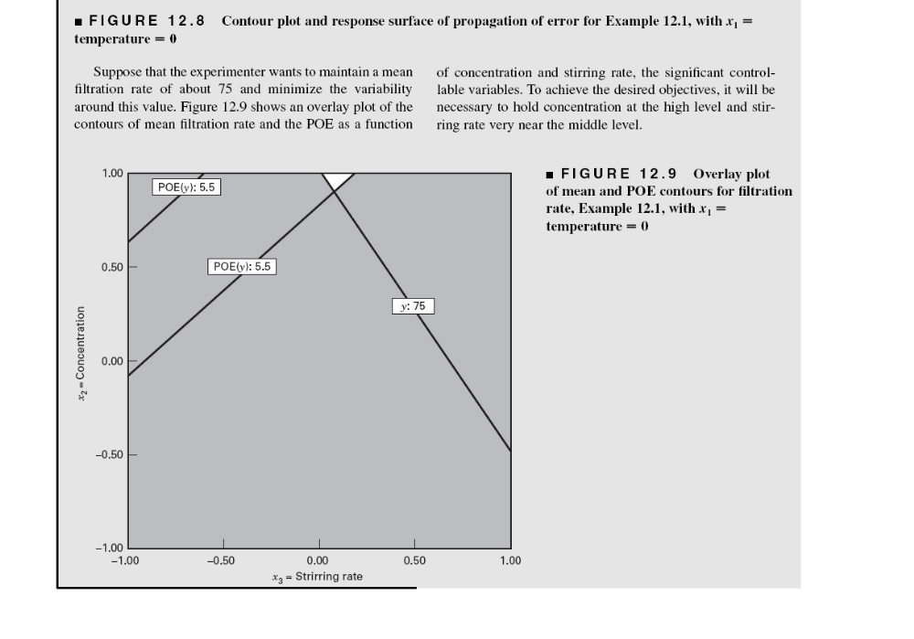
Chapter 12
Design & Analysis of Experiments 8E 2012 Montgomery

Slide 24
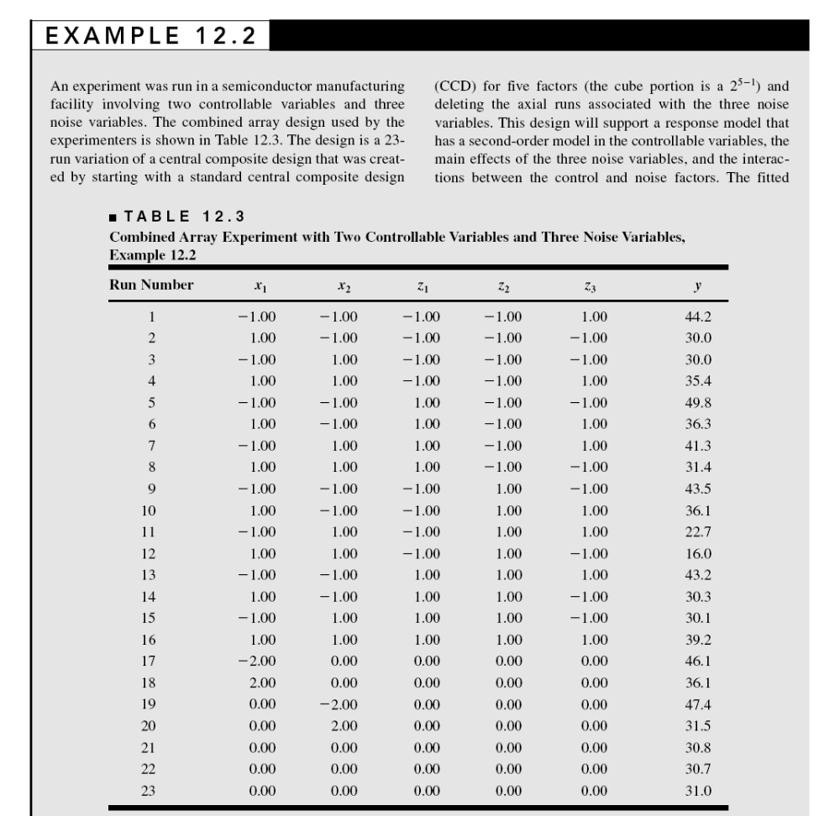
Chapter 12
Design & Analysis of Experiments 8E 2012 Montgomery

Slide 25
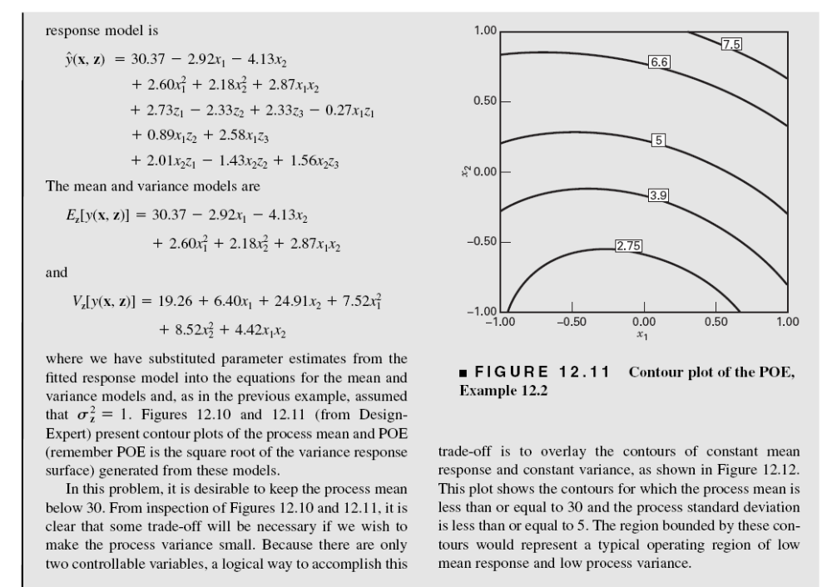
Chapter 12
Design & Analysis of Experiments 8E 2012 Montgomery

Slide 26
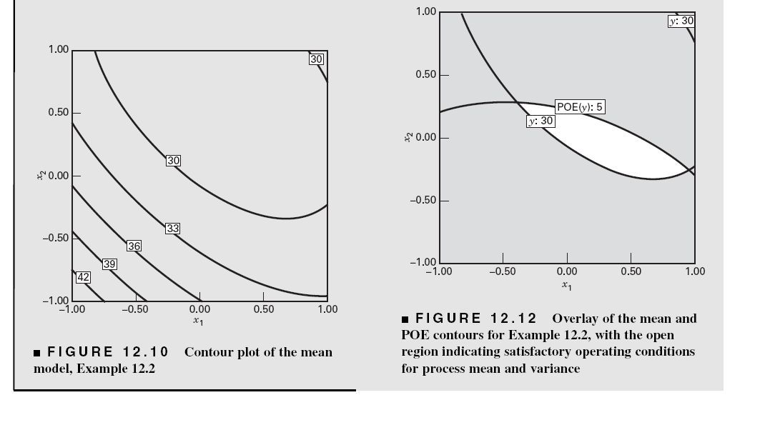
Chapter 12
Design & Analysis of Experiments 8E 2012 Montgomery

Slide 27
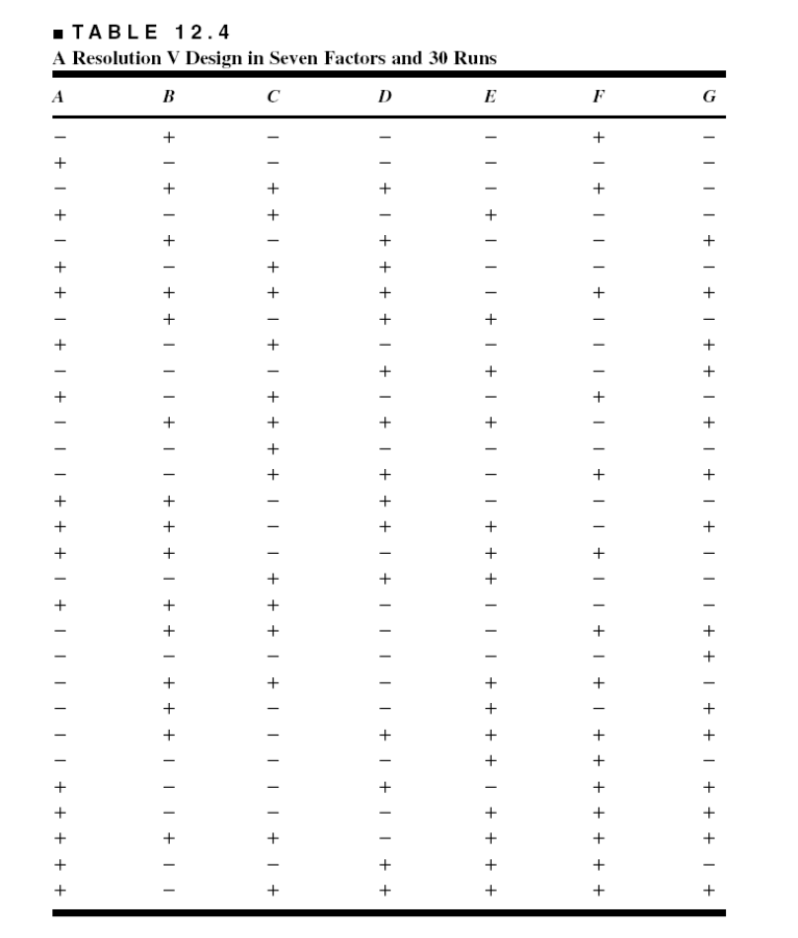
Choice of Designs – First-Order Models
This is a design from Design-Expert
It is a “small” resolution V design
Chapter 12
Design & Analysis of Experiments 8E 2012 Montgomery

Slide 28
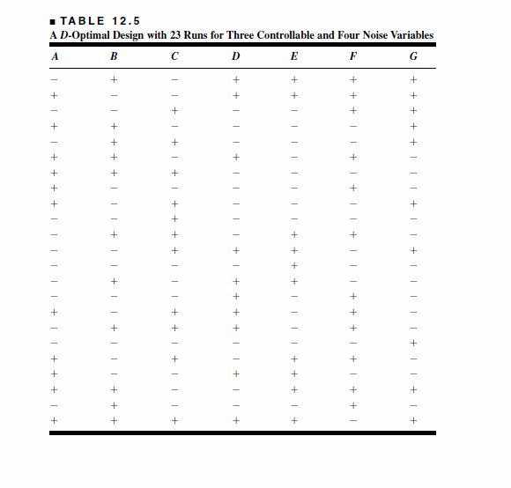
Optimal Designs are Potentially Good Choices in Many Situations
Chapter 12
Design & Analysis of Experiments 8E 2012 Montgomery

Slide 29
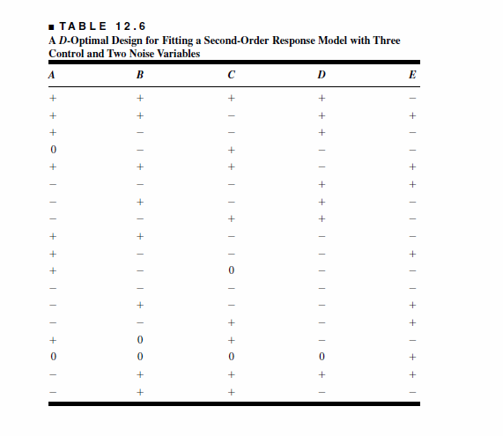
Chapter 12
Design & Analysis of Experiments 8E 2012 Montgomery

Slide 30
Designs for the Second-Order Case
Modified CCDs
  Delete the axial runs along the noise variable axes
  Use 3-5 center runs
Optimal Designs
  JMP and Design-Expert can construct these designs
Chapter 12
Design & Analysis of Experiments 8E 2012 Montgomery

